Slide 1

Analysis of past 120 years of Olympic Games
Group 3: Avinash, Jelena, HoHsin (Heidi), Soumya

Slide 2
Outline
Main question
Data preparation process
Analysis outcome
Conclusion
Data limitations and assumptions
Learnings and takeaway

Slide 3
Main Question
What are the key factors influencing Olympic medal outcomes?
Hosting countries
Medal counts
Seasons
Four example countries
Athlete physical attributes
Age
Weight
Height
Gender ratio
Notes:
Based on the data we have, we can focus our analysis based on the following factors – hosting countries, the s

Slide 4
Data Preparation Process
Kaggle: 120 years of Olympic history: athletes and results
Data cleaning:
Hosting country/city
Age, Weight and sex
Country name
Notes:
The summer Olympic is going to be in France and we think it is interesting to do some analysis based on past 120 years data. What kinds of information is included in the data? (This is a historical dataset on the modern Olympic Games, including all the Games from Athens 1896 to Rio 2016. ) Then we decide to break into 2 group – one focus on country and the other group focus on athlete
Data Preparation Process-
How did you get your data? Did you use API? show a flowchart of steps
What cleaning did you do? A summary of data quality such as missing nans, outliers and how did you handle it? What conditions did you apply? Show examples
What features/ columns you calculated over extracted data? How did you calculate them- their definitions? - Support with vis. such as historgrams, dist. charts, where relvavant
soumya

Slide 5
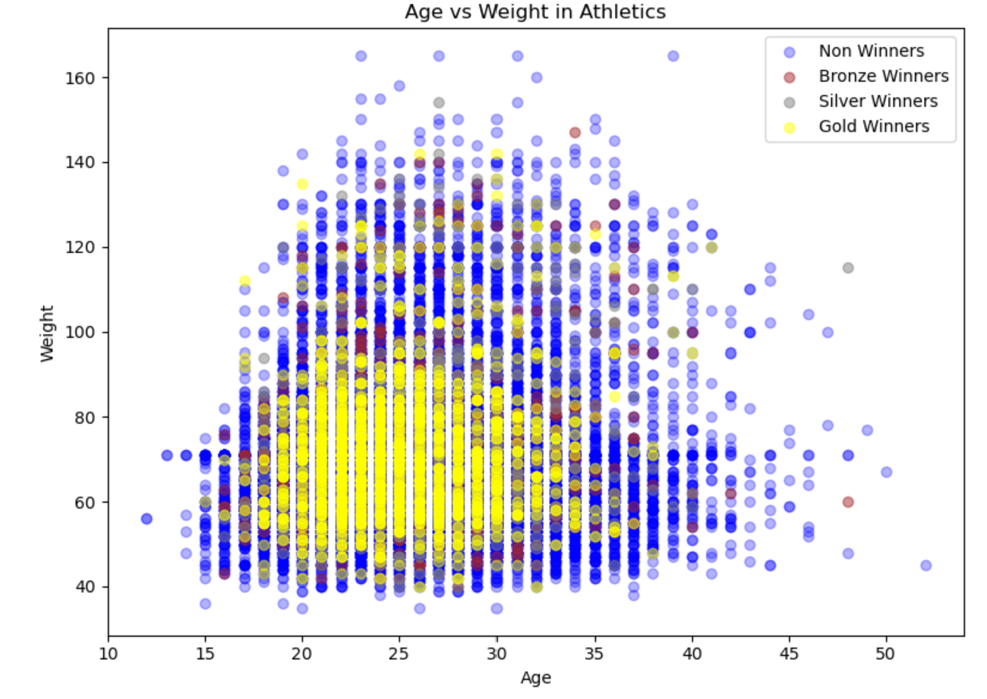
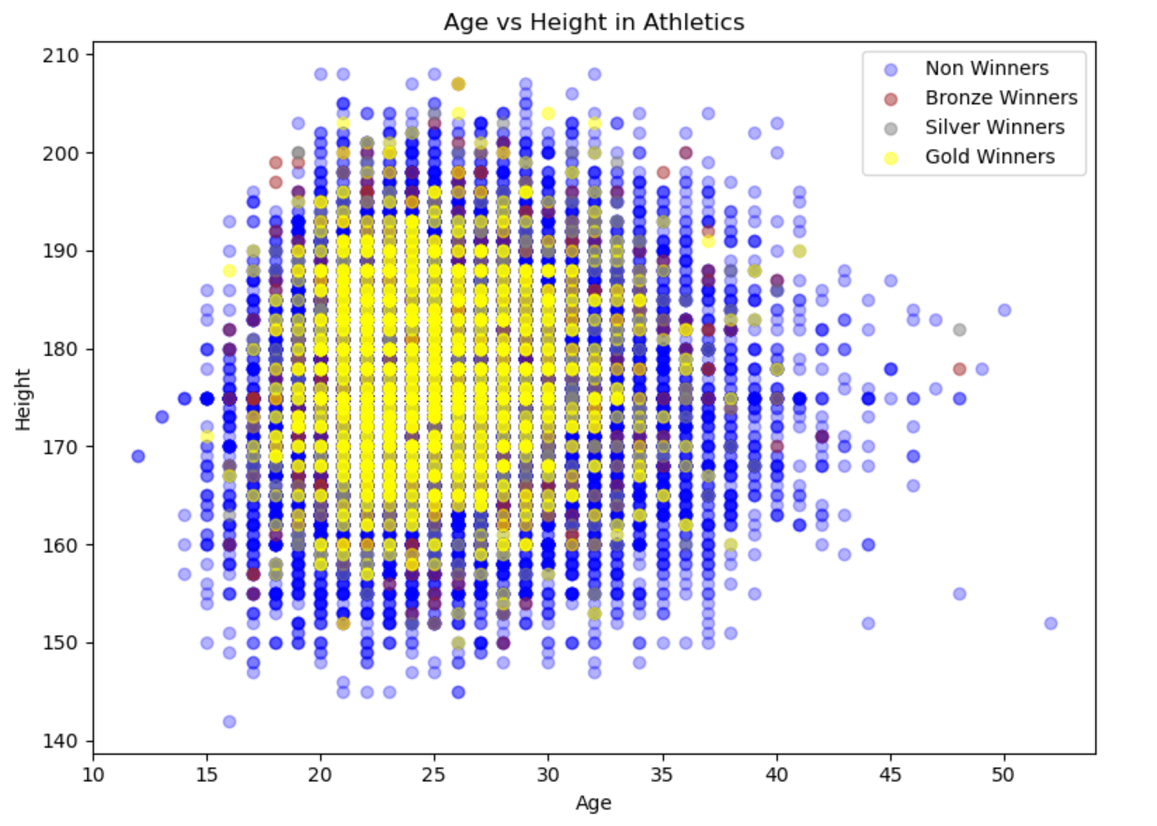
Analysis based on athlete physical attributes
What is the physical attributes of a Gold medalist ?
Notes:
The summer Olympic is going to be in France and we think it is interesting to do some analysis based on past 120 years data

Slide 6
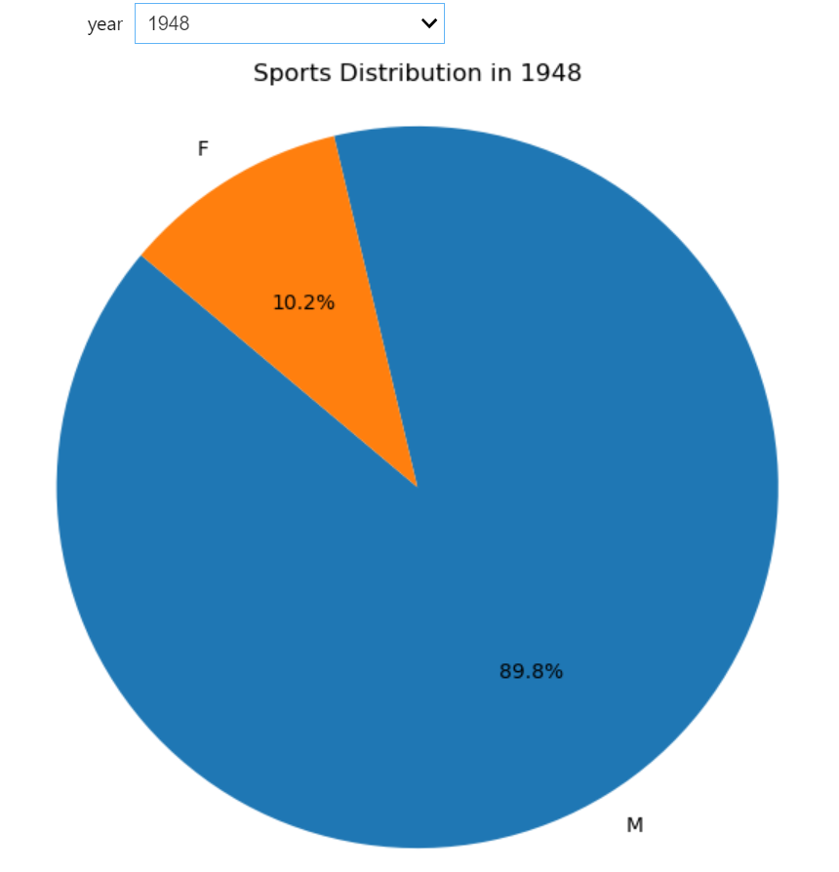
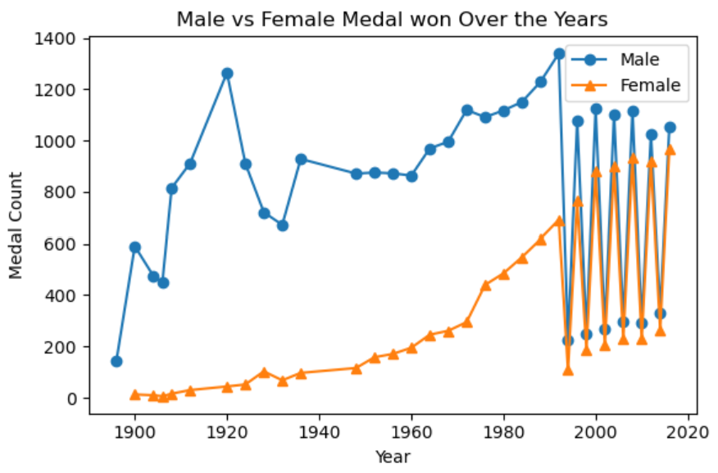
Analysis based on athlete physical attributes
Male vs Female participation
Notes:
The summer Olympic is going to be in France and we think it is interesting to do some analysis based on past 120 years data

Slide 7
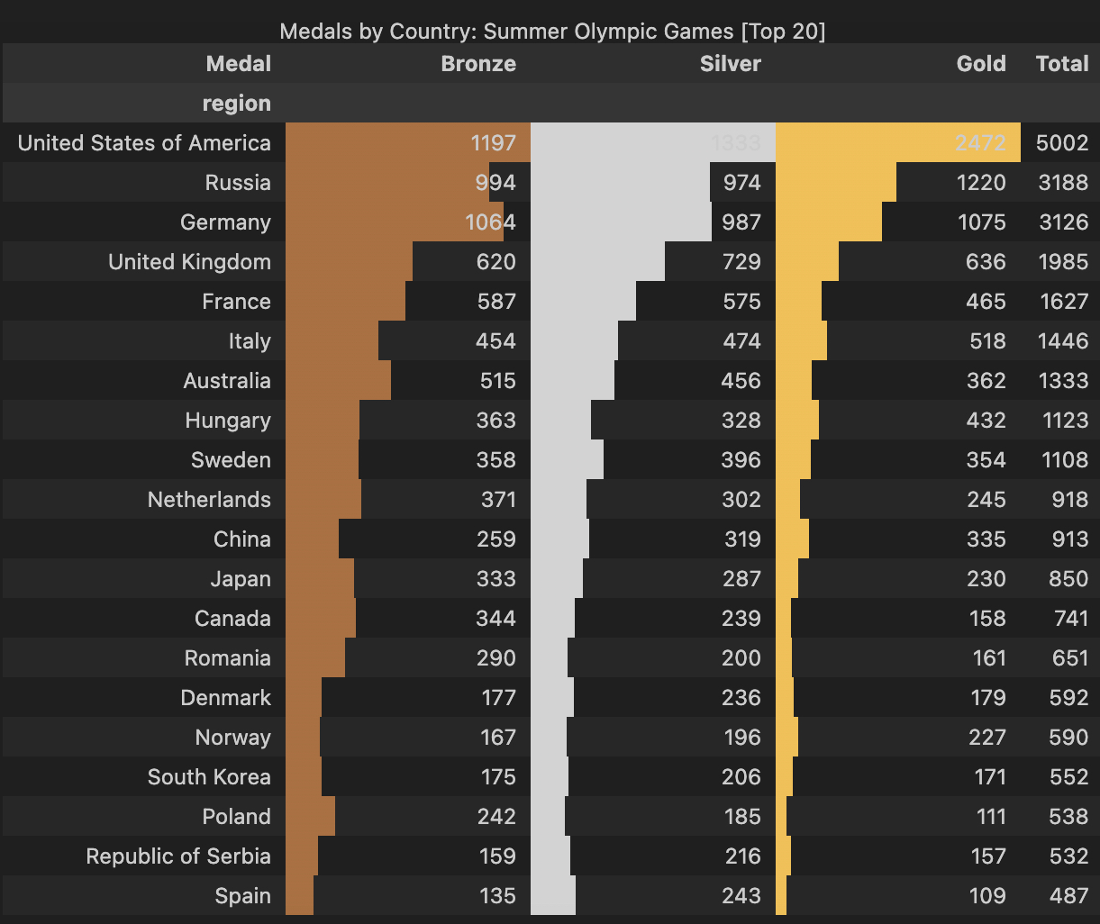
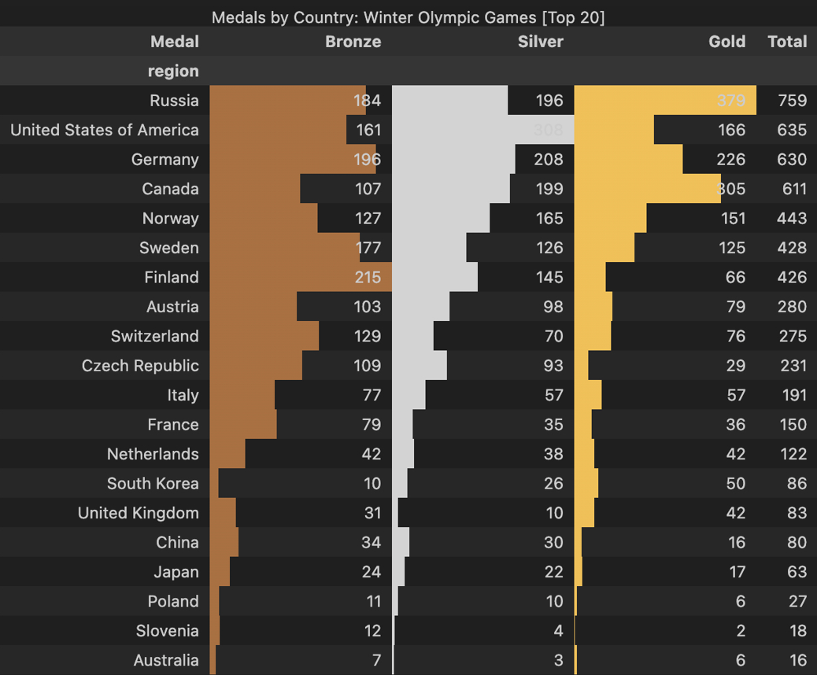
Analysis based on countries
Summer Olympic
Winter Olympic
Notes:
The summer Olympic is going to be in France and we think it is interesting to do some analysis based on past 120 years data

Slide 8
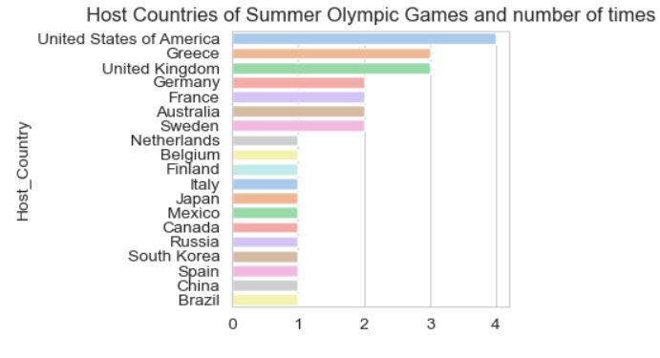
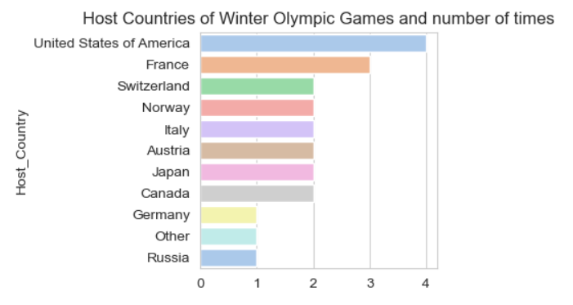
Analysis based on countries
Hosting Countries for Summer Olympic Games
Hosting Countries for Winter Olympic Games
Notes:
The summer Olympic is going to be in France and we think it is interesting to do some analysis based on past 120 years data

Slide 9




Analysis based on countries
Canada
United Kingdom
United States
France
Notes:
The summer Olympic is going to be in France and we think it is interesting to do some analysis based on past 120 years data

Slide 10
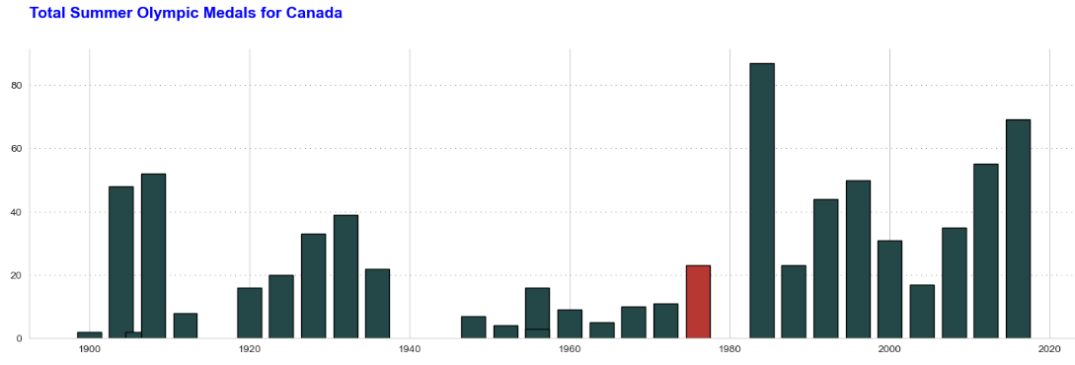
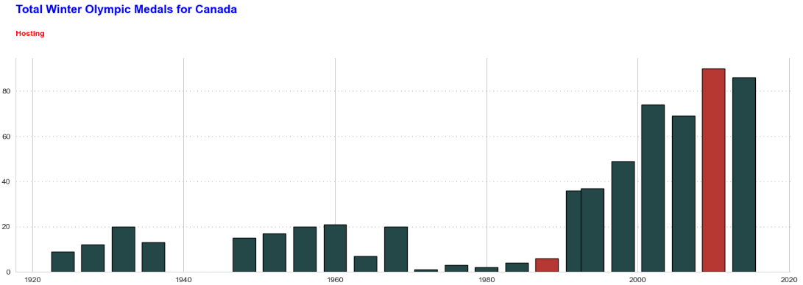
Analysis based on countries
Canada’s performance for Summer Olympic Games
medals
hosting
Canada’s performance for Winter Olympic Games
hosting
medals
hosting
Notes:
The summer Olympic is going to be in France and we think it is interesting to do some analysis based on past 120 years data

Slide 11
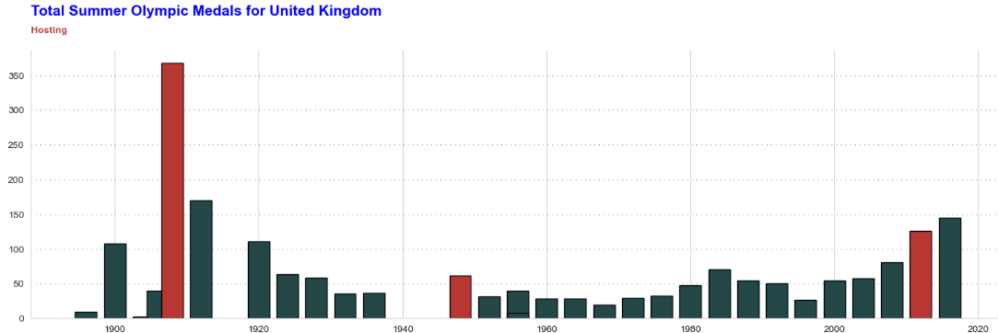
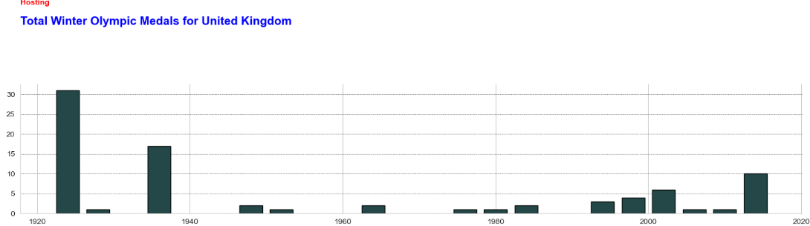
Analysis based on countries
UK’s performance for Summer Olympic Games
hosting
medals
hosting
hosting
UK’s performance for Winter Olympic Games
medals
Notes:
The summer Olympic is going to be in France and we think it is interesting to do some analysis based on past 120 years data

Slide 12
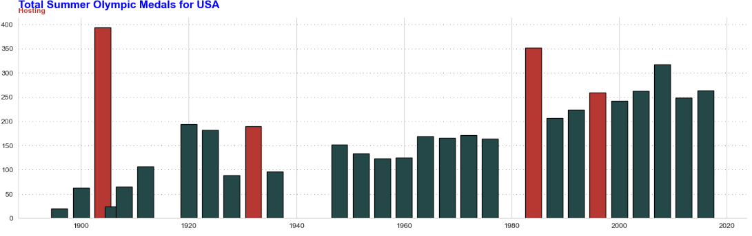
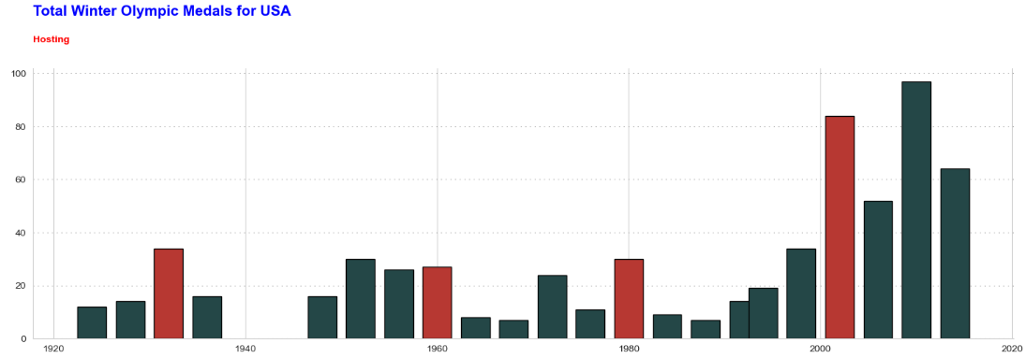
Analysis based on countries
USA’s performance for Summer Olympic Games
hosting
medals
hosting
hosting
hosting
USA’s performance for Winter Olympic Games
hosting
medals
hosting
hosting
hosting
Notes:
The summer Olympic is going to be in France and we think it is interesting to do some analysis based on past 120 years data

Slide 13
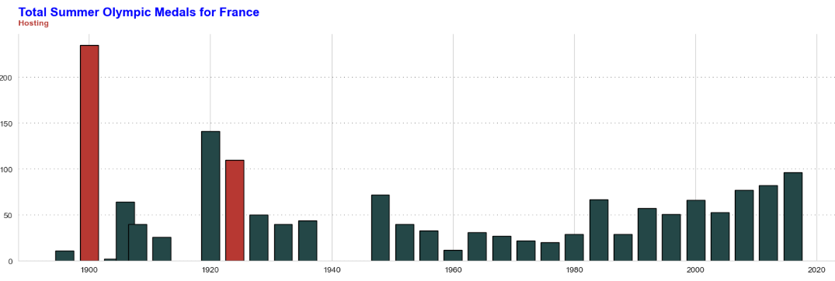
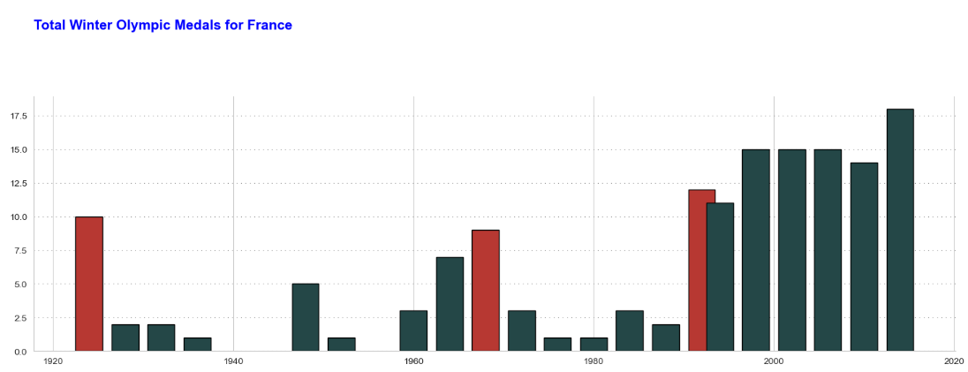
Analysis based on countries
France’s performance for Summer Olympic Games
hosting
medals
hosting
France’s performance for Winter Olympic Games
medals
hosting
hosting
hosting
Notes:
The summer Olympic is going to be in France and we think it is interesting to do some analysis based on past 120 years data

Slide 14
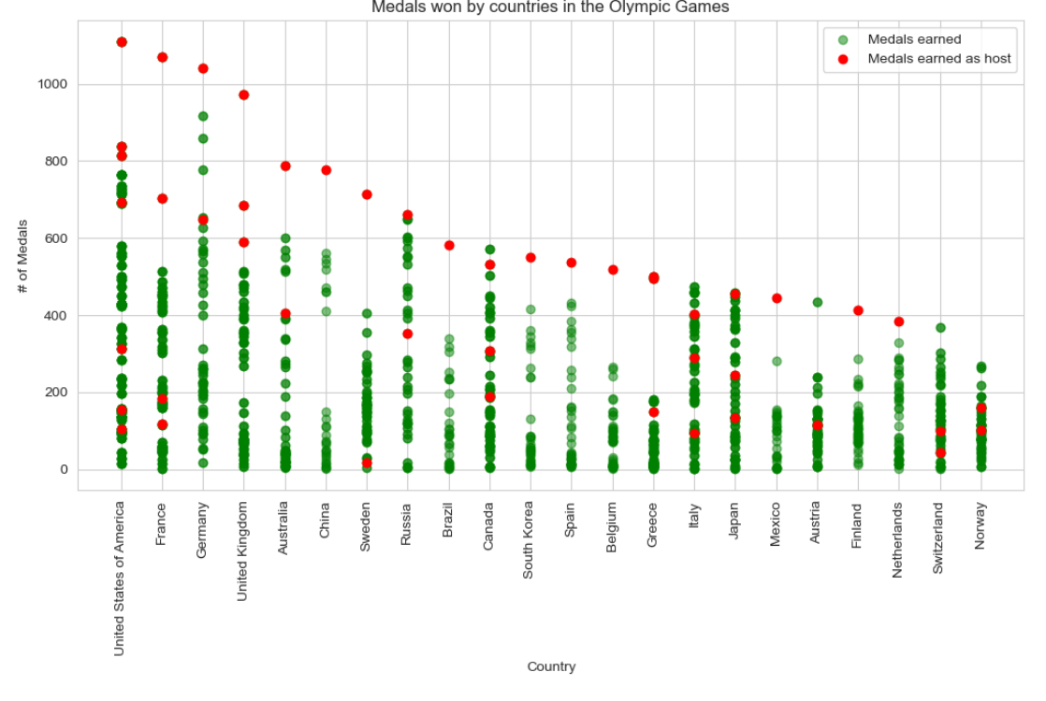
Analysis based on countries
Notes:
The summer Olympic is going to be in France and we think it is interesting to do some analysis based on past 120 years data

Slide 15
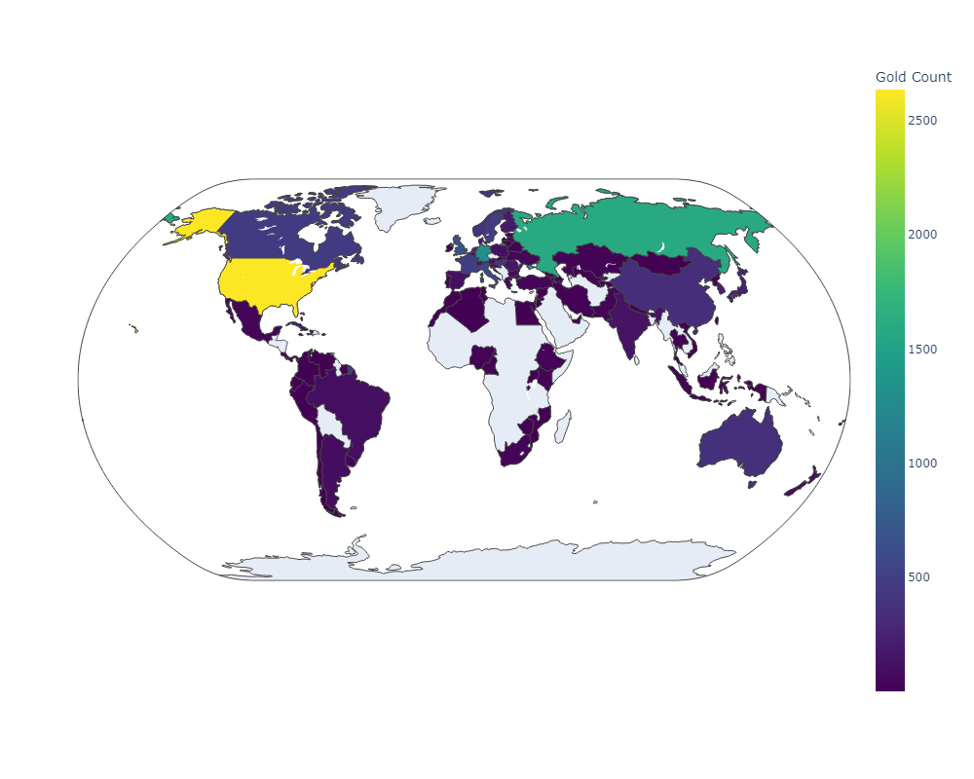
Distribution of gold medals
Notes:
The summer Olympic is going to be in France and we think it is interesting to do some analysis based on past 120 years data

Slide 16
Findings
There is no correlation between physical attributes of a medal winner vs participants.
Country earns more medals when it hosts.
Noticed a trend in increase of women participation in Olympics.
Countries closer to northern hemisphere earn more medals in Winter Olympics.
Canada: had best in Winter games 2010 Vancouver. It was best performance as host country as well as overall winter performance in history with 14 gold medals won! It set all time record for most gold medals at the single winter Olympic.

Slide 17
Conclusion
Conclusions
Limitations and Assumptions
Learnings/Takeaway
Notes:
The summer Olympic is going to be in France and we think it is interesting to do some analysis based on past 120 years data

